Slide 1
User Review Sentiment and Topic Analysis

Slide 2
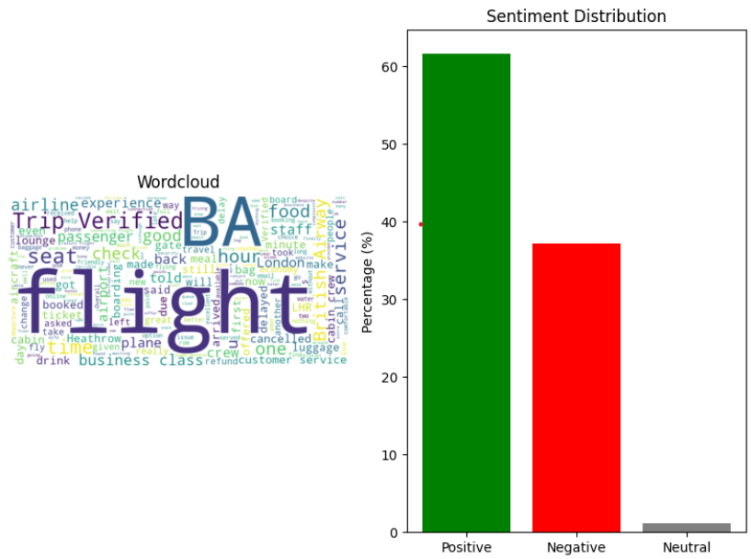
Word Cloud and Sentiment Distribution

